Slide 1

Machine Learning II
INSAID Project
Voice Recognition

Slide 2

Dataset Overview
Goal : predict gender (Male or Female), by understanding voice and speech with Frequency variable [mean, median, mode, deviation, quartile range, skewness, centroid and few other ] , spectral variable [entropy, flatness] and modulation index. Total variables : 21 (Target: 1, Explanatory: 20) Algorithm used : Decision Tree, Random Forests, Boosting and SVM.

Slide 3
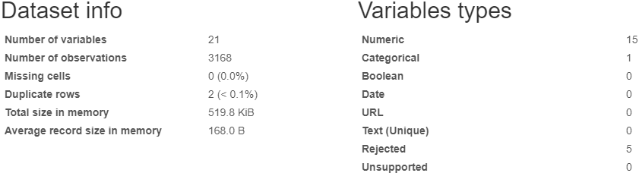
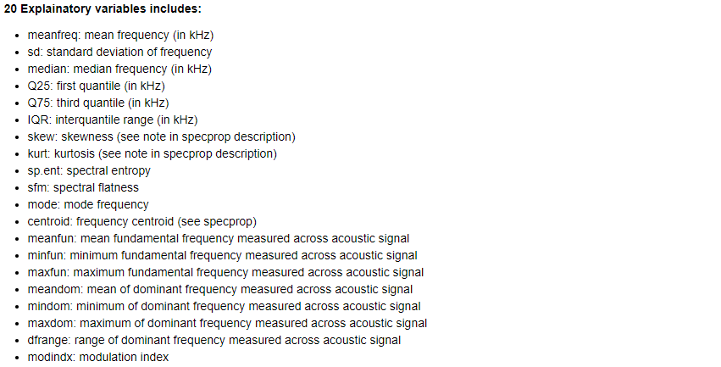
Variables and Exploration

Slide 4
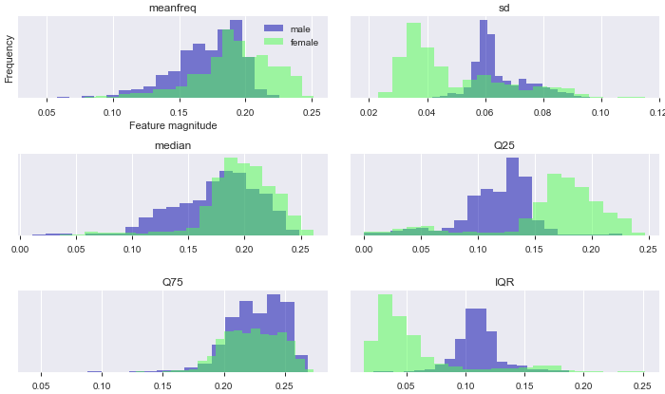
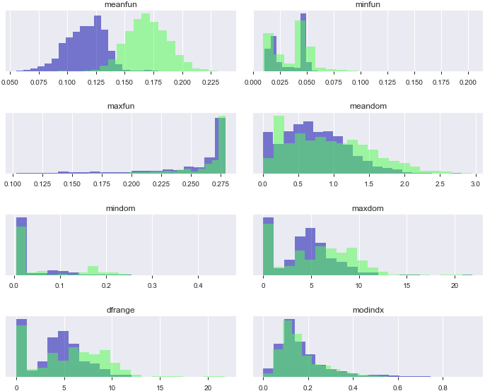
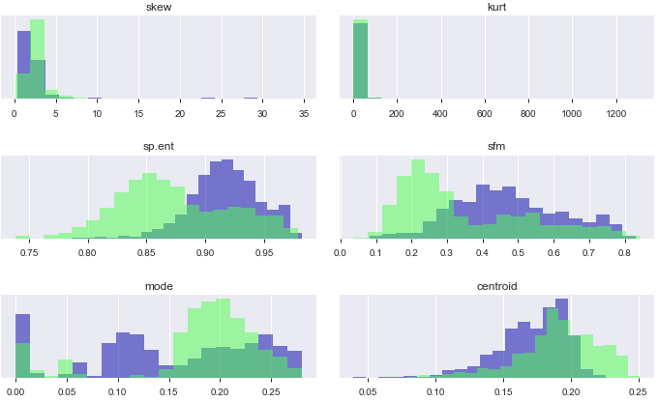
Exploratory Data Analysis (Histogram)
There are 7 variables which help us distinguish between different gender Frequency (Standard Deviation, 25 Quartile range & Inter-Quartile Range, Mode & mean-fun) Spectral (Entropy & Flatness)

Slide 5
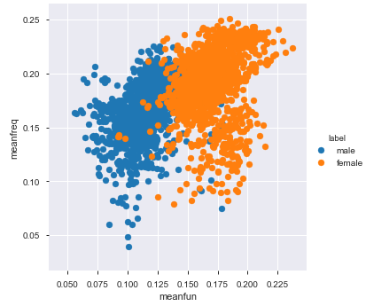
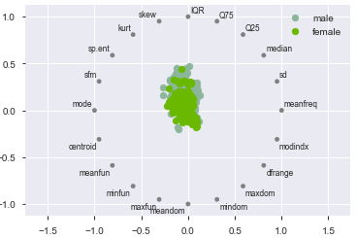
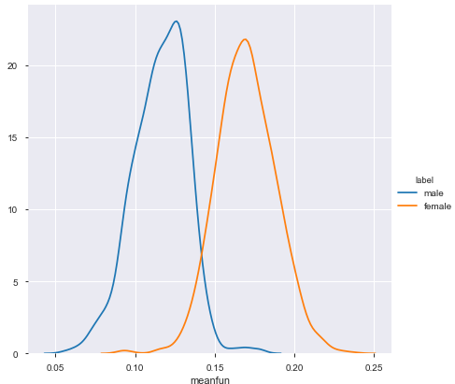
Exploratory Data Analysis
Frequency variables (Mean-Fun and Mean-Frequency) Mean Fun and Mean Frequency is able to distinguish between gender voice.

Slide 6




Model Selection
Algorithm accuracy in Gender Prediction 1. Decision Tree 2. Random Forest 3. Gradient Boosting 4. Support Vector Machine

Slide 7
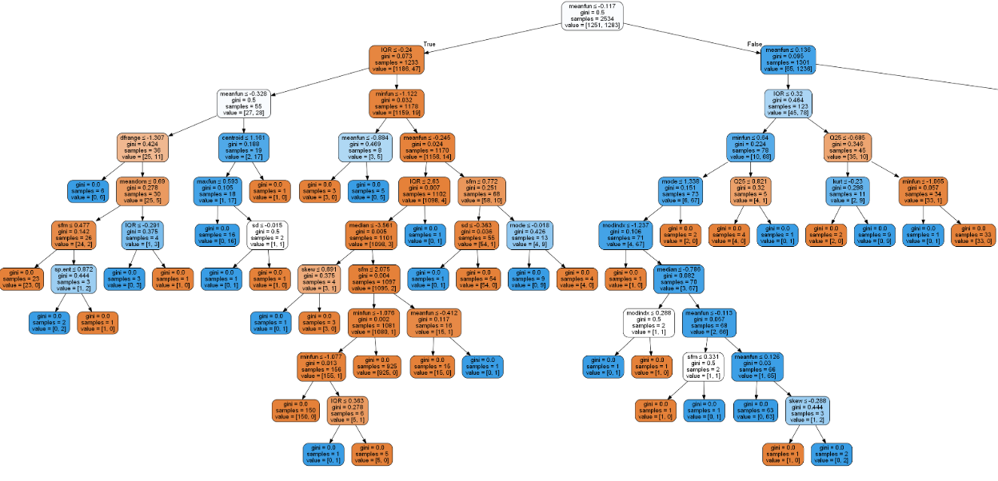
Decision Tree

Slide 8
Questions (if any)
End of Presentation
Send Email to Omsarmalkar@gmail.com

